Slide 1
Marketing Birth Control Products in a Post-Dobbs World
A project to help Pfizer learn from the online conversation about birth control methods
Aaron Galbraith • 2023

Slide 2
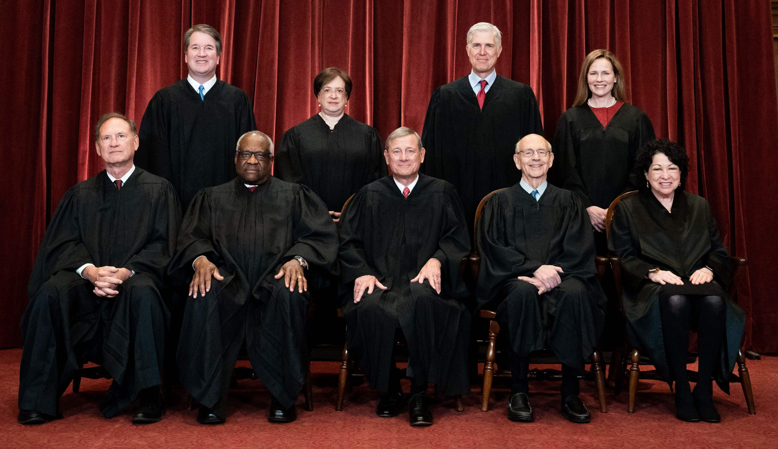


Background
2022 Dobbs ruling
reproductive health conversations
Pfizer

Slide 3
Project Goal
to help Pfizer understand public sentiment toward various birth control methods in order to develop and market their products accordingly

Slide 4
Data
~20,000 reviews from 2008-2017
acquired from drugs.com by researchers at UC Irvine
1-10 rating
7 different birth control methods

Slide 5
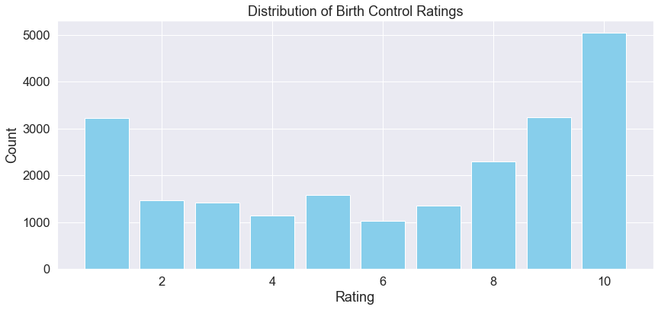
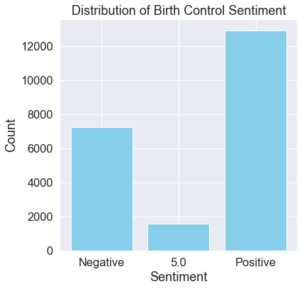

Slide 6
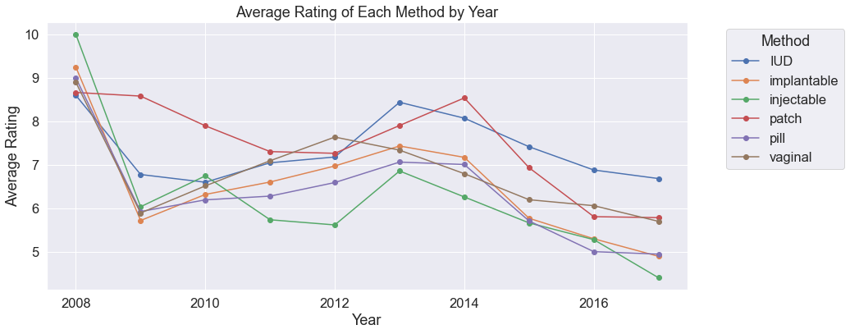

Slide 7
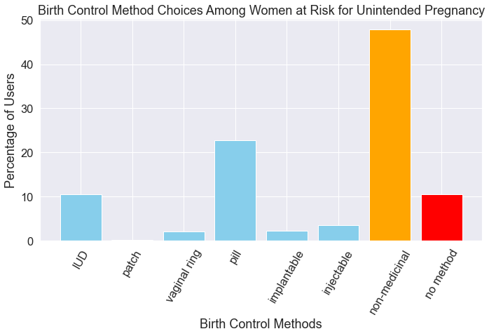
this data from the Guttmacher Institute, 2014

Slide 8
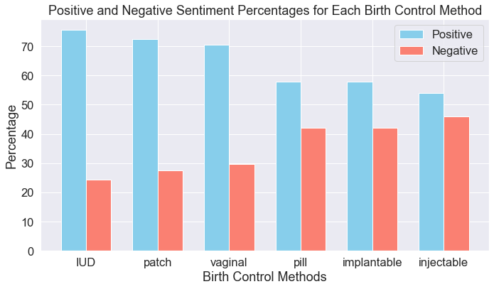

Slide 9
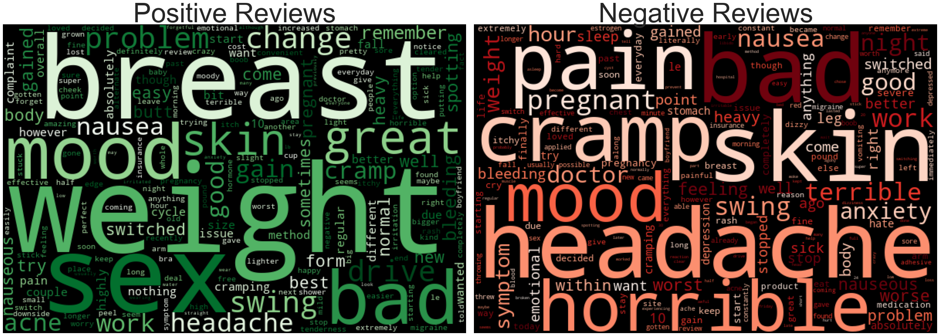
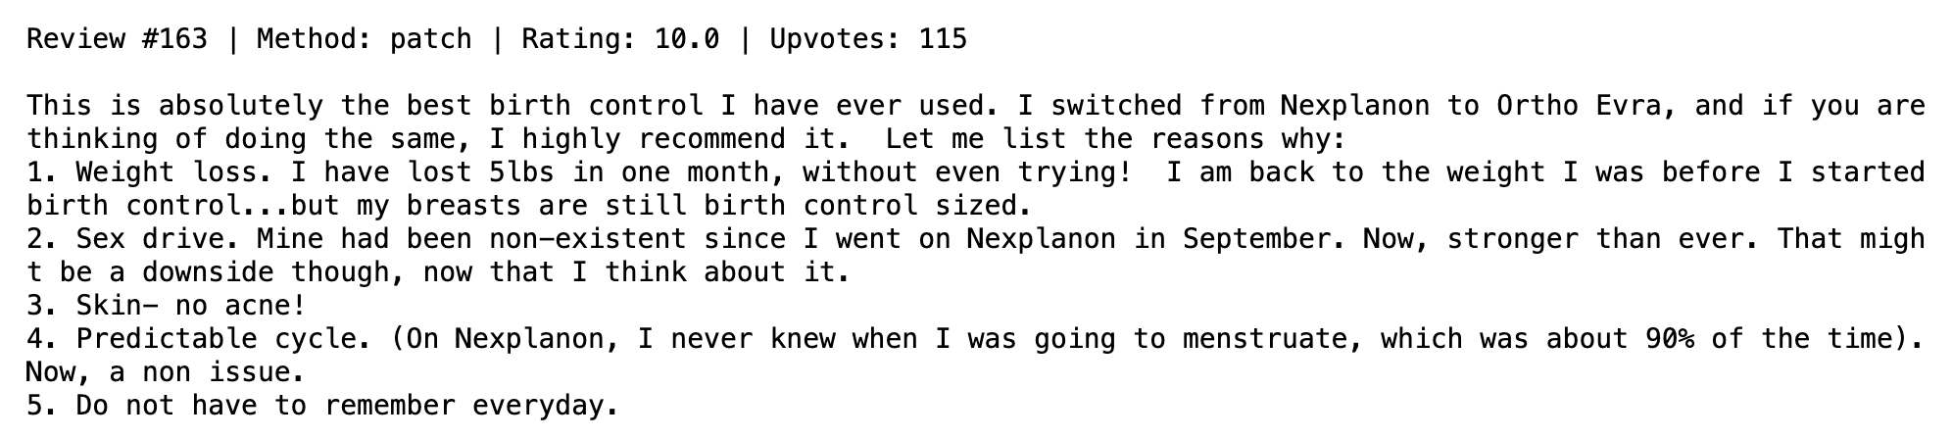
word clouds for patch reviews

Slide 10
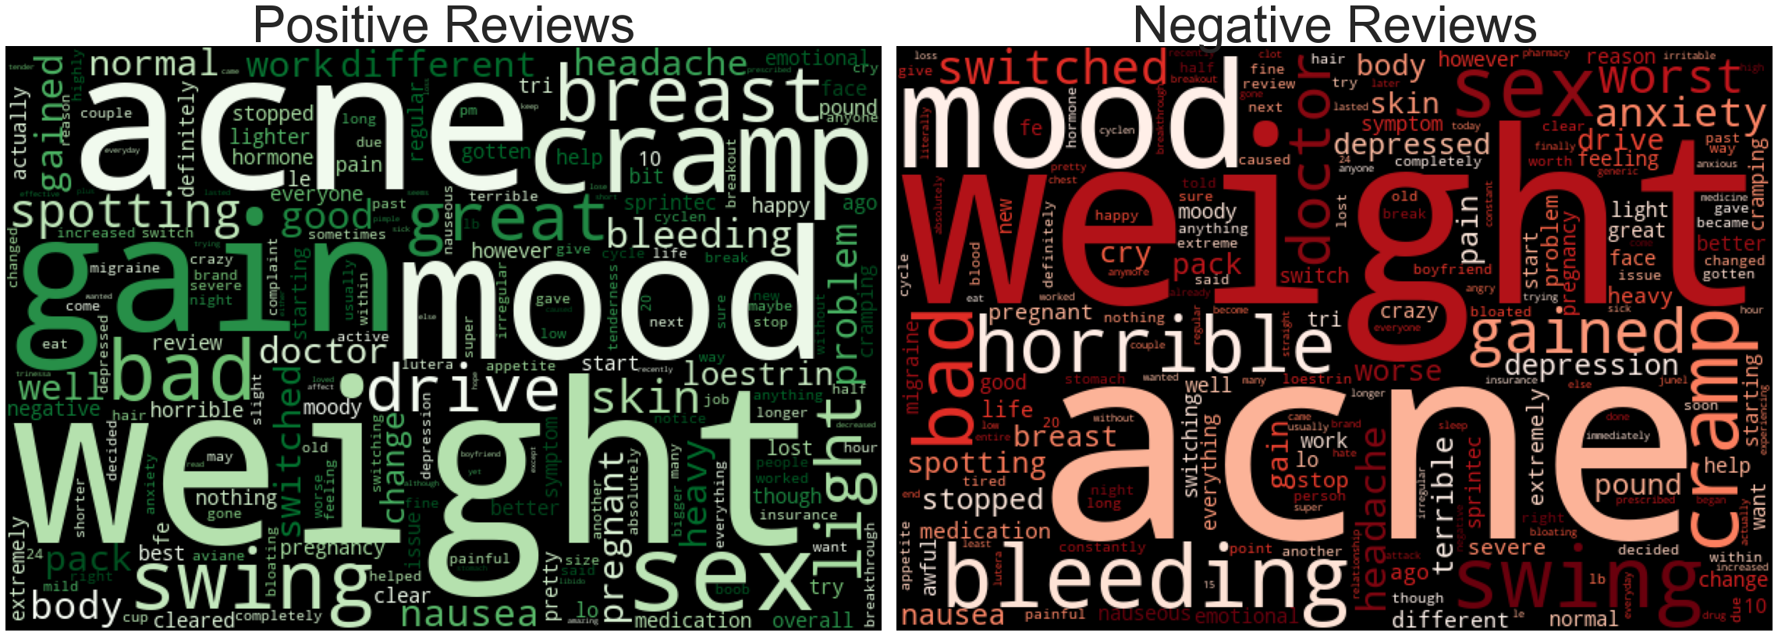
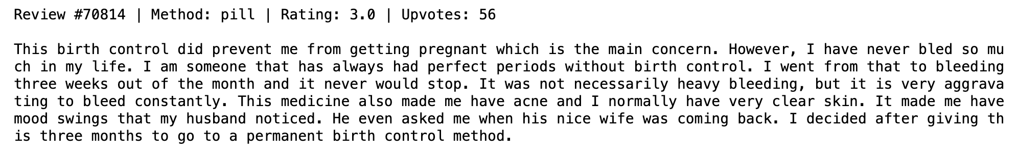
word clouds for pill reviews

Slide 11
Methods
ChatGPT3 helped with brand categorization
feature creation, e.g. readability scores
ML classifiers: Decision Tree, Random Forest, Logistic Regression*
* final model for both predictions
metrics: F1-macro for method prediction & ROC-AUC for sentiment prediction

Slide 12

Model results – predicting METHODS
model | F1-macro | accuracy
Decision Tree (BASELINE) | 0.82 | 87.2%
… with hyperparameter tuning | 0.84 | 88.3%
Random Forest | 0.59 | 83.3%
… with hyperparameter tuning | 0.59 | 83.3%
Logistic Regression | 0.87 | 92.1%
… with hyperparameter tuning | 0.90 | 94.2%

Slide 13
Model results – predicting SENTIMENT
model | ROC-AUC | recall | accuracy
Decision Tree (BASELINE) | 0.69 | 55.2% | 72.6%
… with hyperparameter tuning | 0.75 | 80.5% | 70.8%
Random Forest | 0.92 | 61.3% | 82.4%
… with hyperparameter tuning | 0.93 | 63.0% | 83.1%
Logistic Regression | 0.93 | 96.0% | 77.2%
… with hyperparameter tuning | 0.95 | 91.3% | 86.3%

Slide 14
Recommendations
apply method and sentiment prediction models to online spaces
patch as pill alternative

Slide 15
Further Inquiry
incorporate upvotes
evidence of reviewers switching brands or methods
recommendation algorithm

Slide 16
Thank you
Aaron Galbraith • 2023
www.linkedin.com/in/aarongalbraith

